Slide 1

Evangelism
As a gift
A ministry for some
A lifestyle for all

Slide 2

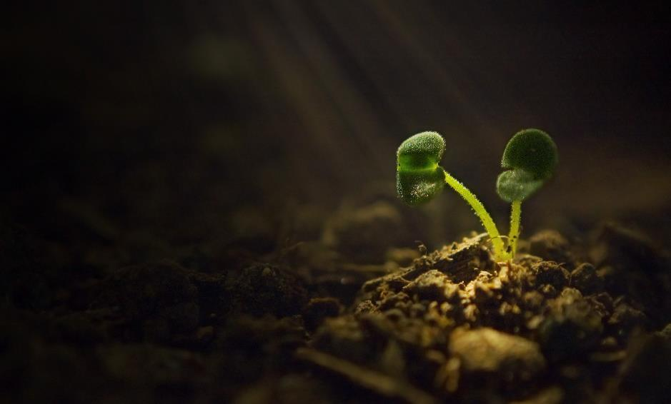
The Brief
“Evangelism as a Gift, a Ministry for some, and a Lifestyle for all”
• Who most demonstrated this gift/ministry in the New Testament Churches?
• Should everyone be an evangelist?
• If not, then how is being a witness to Christ different for the rest of us?
• How can we build the good news into our lifestyle?
• How can evangelists get more effective?
• What does a gift like this look like in practice?
• Why does an evangelistic leader need to be part of a leadership team?

Slide 3
What is an Evangelist?
https://bibleproject.com/videos/euangelion-gospel/
Εὐαγγελιστής - euangelistés
Evangelist - A Good News Announcer

Slide 4
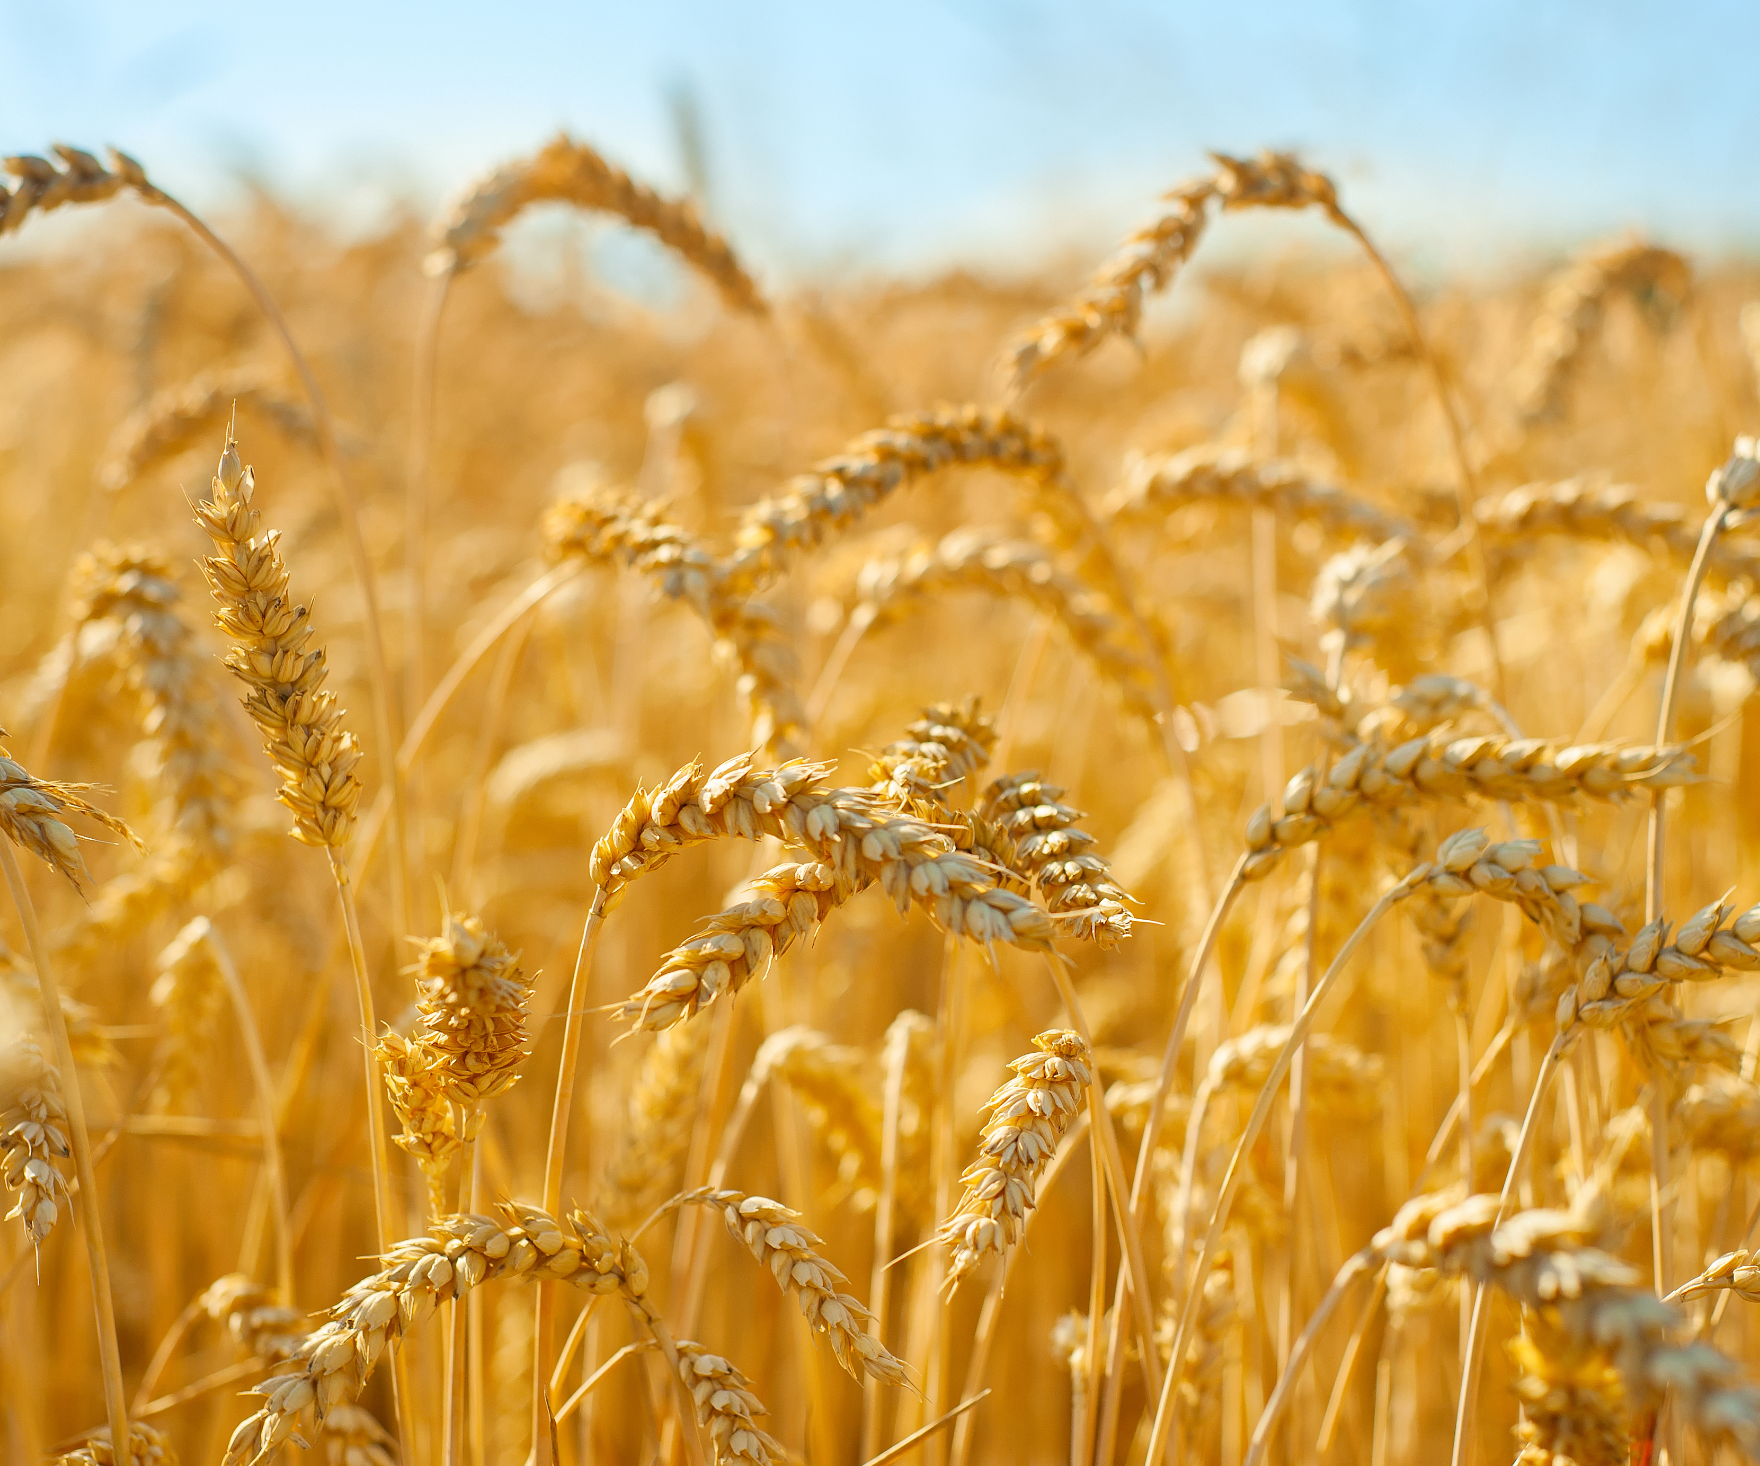
Bible Mentions of Evangelists
Ephesians 11–12 (ESV)
11 And he gave the apostles, the prophets, the evangelists, the shepherds and teachers, 12 to equip the saints for the work of ministry, for building up the body of Christ,
Acts 21:8 (ESV)
8 On the next day we departed and came to Caesarea, and we entered the house of Philip the evangelist, who was one of the seven, and stayed with him.
2 Timothy 4:5 (ESV)
5 As for you, always be sober-minded, endure suffering, do the work of an evangelist, fulfill your ministry.
Notes:
WHAT IS AN EVANGELIST?
• Who most demonstrated this gift/ministry in the New Testament Churches?
• Should everyone be an evangelist?

Slide 5

Ephesians context
Ephesians 4:4-8 then 11–12 (ESV)
4 There is one body and one Spirit—just as you were called to the one hope that belongs to your call— 5 one Lord, one faith, one baptism, 6 one God and Father of all, who is over all and through all and in all. 7 But grace was given to each one of us according to the measure of Christ’s gift. 8 Therefore it says,
“When he ascended on high he led a host of captives,
and he gave gifts to men.”
...
11 And he gave the apostles, the prophets, the evangelists, the shepherds and teachers, 12 to equip the saints for the work of ministry, for building up the body of Christ...

Slide 6

Timothy Context
2 Timothy 4:1–5 (ESV)
1 I charge you in the presence of God and of Christ Jesus, who is to judge the living and the dead, and by his appearing and his kingdom: 2 preach the word; be ready in season and out of season; reprove, rebuke, and exhort, with complete patience and teaching. 3 For the time is coming when people will not endure sound teaching, but having itching ears they will accumulate for themselves teachers to suit their own passions, 4 and will turn away from listening to the truth and wander off into myths. 5 As for you, always be sober-minded, endure suffering, do the work of an evangelist, fulfill your ministry.

Slide 7

Philip the Evangelist
Acts 8 (ESV)
4 Now those who were scattered went about preaching the word. 5 Philip went down to the city of Samaria and proclaimed to them the Christ. 6 And the crowds with one accord paid attention to what was being said by Philip, when they heard him and saw the signs that he did. 7 For unclean spirits, crying out with a loud voice, came out of many who had them, and many who were paralyzed or lame were healed. 8 So there was much joy in that city.
…
12 But when they believed Philip as he preached good news about the kingdom of God and the name of Jesus Christ, they were baptized, both men and women.
…
26 Now an angel of the Lord said to Philip, “Rise and go toward the south to the road that goes down from Jerusalem to Gaza.” This is a desert place...
27 And he rose and went. And there was an Ethiopian, a eunuch, a court official of Candace, queen of the Ethiopians, who was in charge of all her treasure. He had come to Jerusalem to worship 28 and was returning, seated in his chariot, and he was reading the prophet Isaiah.
Notes:
Acts 6:1–7 (ESV)
1 Now in these days when the disciples were increasing in number, a complaint by the Hellenists arose against the Hebrews because their widows were being neglected in the daily distribution. 2 And the twelve summoned the full number of the disciples and said, “It is not right that we should give up preaching the word of God to serve tables. 3 Therefore, brothers, pick out from among you seven men of good repute, full of the Spirit and of wisdom, whom we will appoint to this duty. 4 But we will devote ourselves to prayer and to the ministry of the word.” 5 And what they said pleased the whole gathering, and they chose Stephen, a man full of faith and of the Holy Spirit, and Philip, and Prochorus, and Nicanor, and Timon, and Parmenas, and Nicolaus, a proselyte of Antioch. 6 These they set before the apostles, and they prayed and laid their hands on them.
7 And the word of God continued to increase, and the number of the disciples multiplied greatly in Jerusalem, and a great many of the priests became obedient to the faith.
Acts 8 (ESV)
4 Now those who were scattered went about preaching the word. 5 Philip went down to the city of Samaria and proclaimed to them the Christ. 6 And the crowds with one accord paid attention to what was being said by Philip, when they heard him and saw the signs that he did. 7 For unclean spirits, crying out with a loud voice, came out of many who had them, and many who were paralyzed or lame were healed. 8 So there was much joy in that city.
…
12 But when they believed Philip as he preached good news about the kingdom of God and the name of Jesus Christ, they were baptized, both men and women.
…
26 Now an angel of the Lord said to Philip, “Rise and go toward the south to the road that goes down from Jerusalem to Gaza.” This is a desert place...
27 And he rose and went. And there was an Ethiopian, a eunuch, a court official of Candace, queen of the Ethiopians, who was in charge of all her treasure. He had come to Jerusalem to worship 28 and was returning, seated in his chariot, and he was reading the prophet Isaiah. 29 And the Spirit said to Philip, “Go over and join this chariot.” 30 So Philip ran to him and heard him reading Isaiah the prophet and asked, “Do you understand what you are reading?” 31 And he said, “How can I, unless someone guides me?” And he invited Philip to come up and sit with him.
…
35 Then Philip opened his mouth, and beginning with this Scripture he told him the good news about Jesus. 36 And as they were going along the road they came to some water, and the eunuch said, “See, here is water! What prevents me from being baptized?” 38 And he commanded the chariot to stop, and they both went down into the water, Philip and the eunuch, and he baptized him. 39 And when they came up out of the water, the Spirit of the Lord carried Philip away, and the eunuch saw him no more, and went on his way rejoicing. 40 But Philip found himself at Azotus, and as he passed through he preached the gospel to all the towns until he came to Caesarea.

Slide 8
Philip the Evangelist
Acts 8 (ESV)
29 And the Spirit said to Philip, “Go over and join this chariot.” 30 So Philip ran to him and heard him reading Isaiah the prophet and asked, “Do you understand what you are reading?” 31 And he said, “How can I, unless someone guides me?” And he invited Philip to come up and sit with him.
…
35 Then Philip opened his mouth, and beginning with this Scripture he told him the good news about Jesus. 36 And as they were going along the road they came to some water, and the eunuch said, “See, here is water! What prevents me from being baptized?” 38 And he commanded the chariot to stop, and they both went down into the water, Philip and the eunuch, and he baptized him. 39 And when they came up out of the water, the Spirit of the Lord carried Philip away, and the eunuch saw him no more, and went on his way rejoicing. 40 But Philip found himself at Azotus, and as he passed through he preached the gospel to all the towns until he came to Caesarea.
Notes:
Acts 6:1–7 (ESV)
1 Now in these days when the disciples were increasing in number, a complaint by the Hellenists arose against the Hebrews because their widows were being neglected in the daily distribution. 2 And the twelve summoned the full number of the disciples and said, “It is not right that we should give up preaching the word of God to serve tables. 3 Therefore, brothers, pick out from among you seven men of good repute, full of the Spirit and of wisdom, whom we will appoint to this duty. 4 But we will devote ourselves to prayer and to the ministry of the word.” 5 And what they said pleased the whole gathering, and they chose Stephen, a man full of faith and of the Holy Spirit, and Philip, and Prochorus, and Nicanor, and Timon, and Parmenas, and Nicolaus, a proselyte of Antioch. 6 These they set before the apostles, and they prayed and laid their hands on them.
7 And the word of God continued to increase, and the number of the disciples multiplied greatly in Jerusalem, and a great many of the priests became obedient to the faith.
Acts 8 (ESV)
4 Now those who were scattered went about preaching the word. 5 Philip went down to the city of Samaria and proclaimed to them the Christ. 6 And the crowds with one accord paid attention to what was being said by Philip, when they heard him and saw the signs that he did. 7 For unclean spirits, crying out with a loud voice, came out of many who had them, and many who were paralyzed or lame were healed. 8 So there was much joy in that city.
…
12 But when they believed Philip as he preached good news about the kingdom of God and the name of Jesus Christ, they were baptized, both men and women.
…
26 Now an angel of the Lord said to Philip, “Rise and go toward the south to the road that goes down from Jerusalem to Gaza.” This is a desert place...
27 And he rose and went. And there was an Ethiopian, a eunuch, a court official of Candace, queen of the Ethiopians, who was in charge of all her treasure. He had come to Jerusalem to worship 28 and was returning, seated in his chariot, and he was reading the prophet Isaiah. 29 And the Spirit said to Philip, “Go over and join this chariot.” 30 So Philip ran to him and heard him reading Isaiah the prophet and asked, “Do you understand what you are reading?” 31 And he said, “How can I, unless someone guides me?” And he invited Philip to come up and sit with him.
…
35 Then Philip opened his mouth, and beginning with this Scripture he told him the good news about Jesus. 36 And as they were going along the road they came to some water, and the eunuch said, “See, here is water! What prevents me from being baptized?” 38 And he commanded the chariot to stop, and they both went down into the water, Philip and the eunuch, and he baptized him. 39 And when they came up out of the water, the Spirit of the Lord carried Philip away, and the eunuch saw him no more, and went on his way rejoicing. 40 But Philip found himself at Azotus, and as he passed through he preached the gospel to all the towns until he came to Caesarea.

Slide 9

An evangelist is a Good News Messenger
Notes:
Luke 4:16–21 (ESV)
16 And he came to Nazareth, where he had been brought up. And as was his custom, he went to the synagogue on the Sabbath day, and he stood up to read. 17 And the scroll of the prophet Isaiah was given to him. He unrolled the scroll and found the place where it was written,
18 “The Spirit of the Lord is upon me,
because he has anointed me
to proclaim good news to the poor. (euangelizo – evangelise!)
He has sent me to proclaim liberty to the captives
and recovering of sight to the blind,
to set at liberty those who are oppressed,
19 to proclaim the year of the Lord’s favor.”
20 And he rolled up the scroll and gave it back to the attendant and sat down. And the eyes of all in the synagogue were fixed on him. 21 And he began to say to them, “Today this Scripture has been fulfilled in your hearing.”

Slide 10

The Matthew 28 Game Plan
Matthew 28:18–20 (ESV)
18 And Jesus came and said to them, “All authority in heaven and on earth has been given to me.
19 Go therefore and make disciples of all nations, baptizing them in the name of the Father and of the Son and of the Holy Spirit,
20 teaching them to observe all that I have commanded you. And behold, I am with you always, to the end of the age.”

Slide 11
Summary
“Evangelism as a Gift, a Ministry for some, and a Lifestyle for all”
• Who most demonstrated this gift/ministry in the New Testament Churches?
• Should everyone be an evangelist?
• If not, then how is being a witness to Christ different for the rest of us?
• How can we build the good news into our lifestyle?
• How can evangelists get more effective?
• What does a gift like this look like in practice?
• Why does an evangelistic leader need to be part of a leadership team?

